Slide 1

Apache Web server and Self-conteined deployment

Slide 2
Agenda
What is a Web Server?
Most popular Web Servers
What do We need for deploy ASP Core app?
.NET Core Runtime Deployment Options

Slide 3
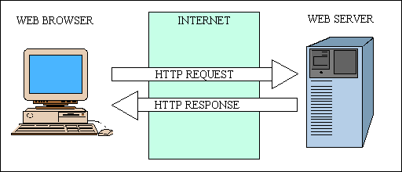
What is a Web Server?
A web server is a computer system that processes requests via HTTP, the basic network protocol used to distribute information on the World Wide Web. The term can refer to the entire system, or specifically to the software that accepts and supervises the HTTP requests

Slide 4
Most popular Web Servers

Slide 5
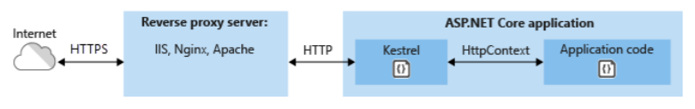
What do We need for deploy ASP Core app?
.Net core application
Server with CentOs 7
Install Apache as reverse proxy server.
Configurate Kestrel Server

Slide 6
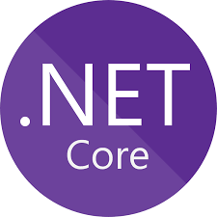
.NET Core Runtime Deployment Options
Framework Dependent Deployment (FDD)
Self-contained Deployment (SCD)
.NET Runtime
.NET Runtime

Slide 7
FDD | SCD
Dependencies of .Net core | Full autonomy
You don't have to define the target operating systems that your .NET Core app will run on in advance. | You must select the target platforms for which you build deployment packages in advance
It's possible for the .NET Core runtime and libraries to change without your knowledge in future releases. In rare cases, this may change the behavior of your app. | You can be assured that the target system can run your .NET Core app, since you're providing the version of .NET Core that it will run on.
Small size | Large size

